Slide 1





CREDIT CARD FRAUD DETECTION
ps/pq
GROUP u

Slide 2


CREDIT CARD FRAUD DETECTION
Members:
Fayez Ahmad (0431346)
Khushi Dipakkumar Bhabhor (0444179)
Leyon Ibn Kamal (0441985)
Logesh Guhan Narayanamoorthy (0439721)
Roya Bakhshi (0428349)
Course Instructor : Jaspreet Bhatia

Slide 3
INTRODUCTION
Credit card fraud detection is a collective term for the policies, tools, methodologies, and practices that credit card companies and financial institutions take to combat identity fraud and stop fraudulent transactions.
Credit card fraud happens when someone steals or uses your credit card or credit card information without your permission.

Slide 4
WHY IT IS REQUIRED?
In the recent years, credit card fraud has become the leading source of identity based thefts especially after the recent pandemic.
It is important for the credit card companies to recognize fraudulent transactions so that customers are not charged for items they did not purchase.

Slide 5










PIPELINE
.csv dataset
Cloud Storage Bucket
BigQuery Dataset
Data
Check data using BigQuery
SQL query
Vertex AI dataset
Vertex AI AutoML
Machine Learning
BigQuery Tabular dataset
Classification Model
Vertex AI Endpoints
for online prediction
(Only best model is
Selected)
Vertex AI Workbench
PyTorch GRU Model

Slide 6
DATASET
European Cardholders 2023
550,000 records
Key Features:
id: Unique identifier for each transaction
Anonymized features representing various transactions (time, location etc.)
Amount: The transaction amount
Class : Binary label – Fradulent (1) or not (0)
Balanced Dataset

Slide 7
CLOUD STORAGE
Google Cloud Storage is a managed service for storing unstructured data.
It is an object storage system, meaning it stores data as objects rather than files in an hierarchical file system.
We used cloud storage to store the CSV dataset that we collected from Kaggle.

Slide 8
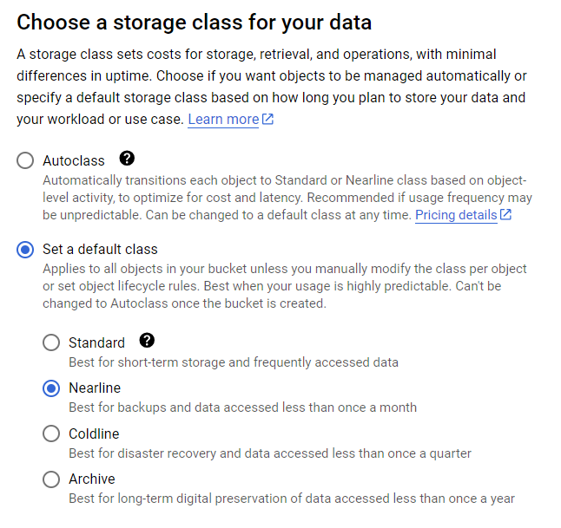
CLOUD STORAGE

Slide 9
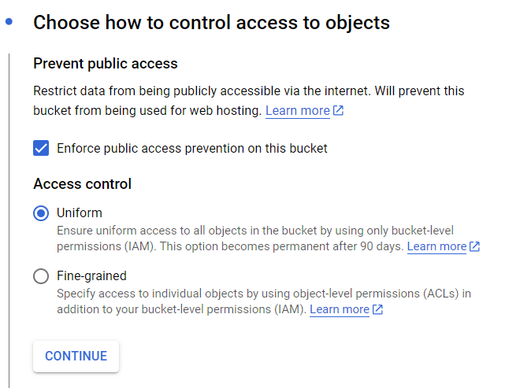
CLOUD STORAGE

Slide 10
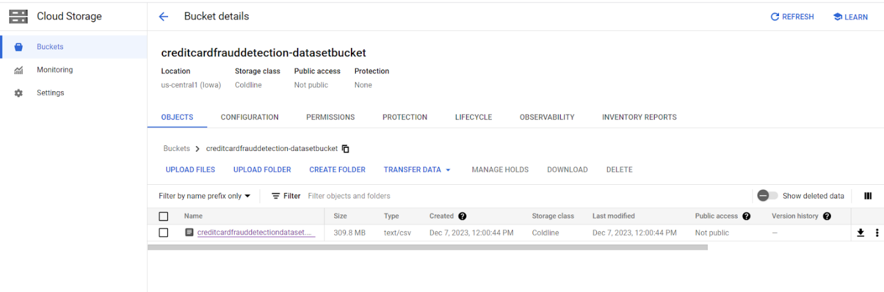
CLOUD STORAGE

Slide 11
BIGQUERY
BigQuery is a serverless and cost-effective enterprise data warehouse that works across clouds and scales with your data.
SQL-like language for querying and analysing the data.
Handle large-scale datasets with ease.
Good for data warehousing – store customer transactions data

Slide 12
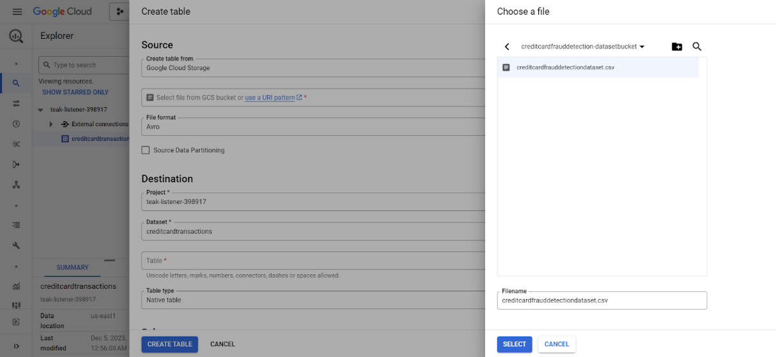
BIGQUERY

Slide 13
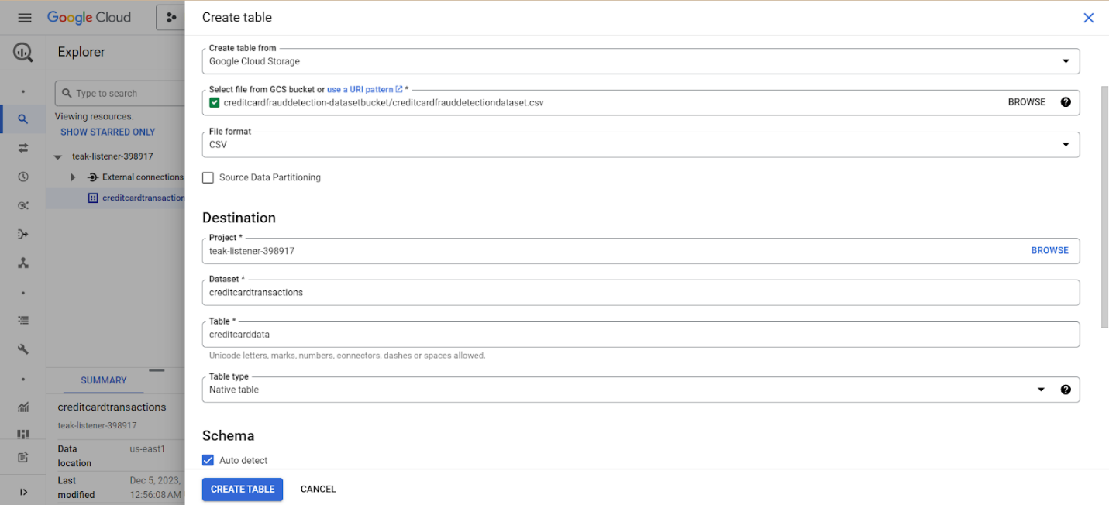
BIGQUERY

Slide 14
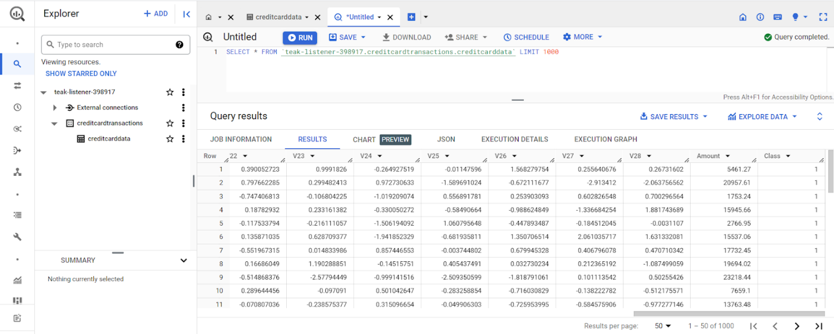
BIGQUERY

Slide 15
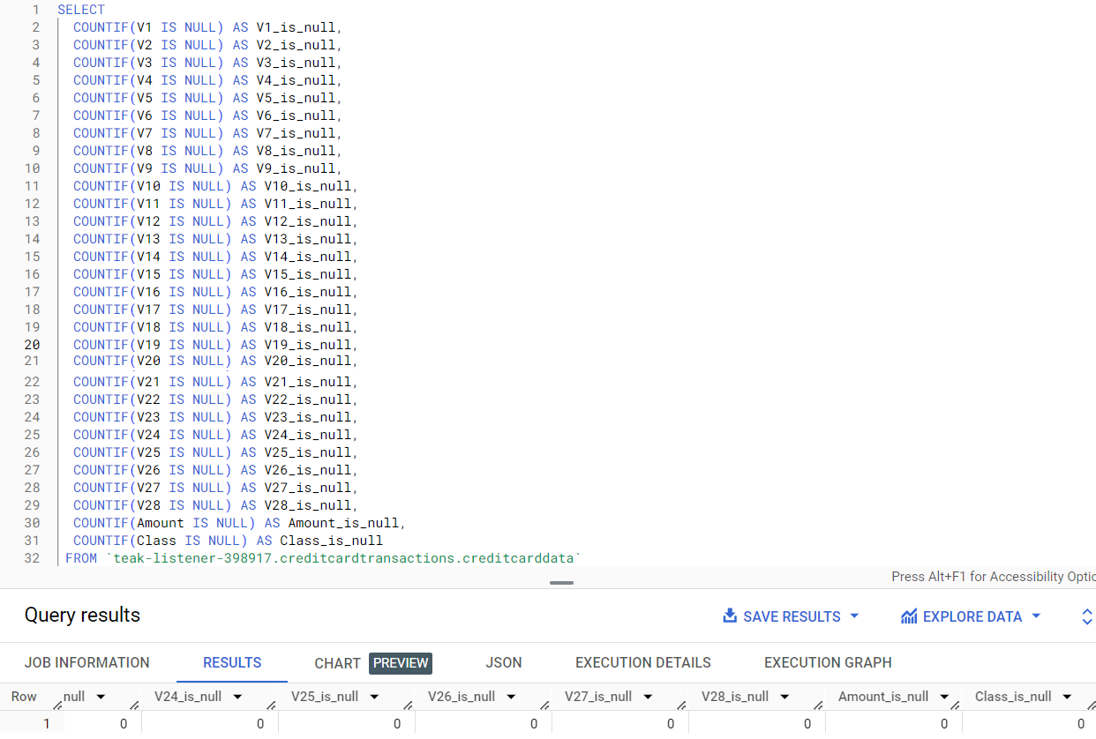
BIGQUERY

Slide 16
VERTEX AI
A machine learning platform to train and deploy ML models and AI apps.
Vertex AI Workbench, Datasets, Auto ML, Model Registry and Endpoint.
Vertex AI Workbench provides managed JupyterLab notebook.
Pytorch for custom model – simple GRU based model.

Slide 17
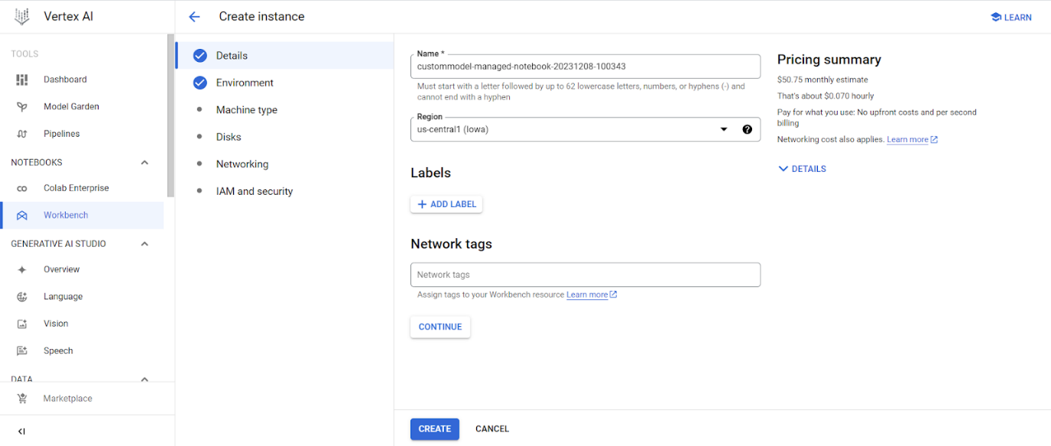
WORKBENCH AND CUSTOM MODEL TRAINING

Slide 18
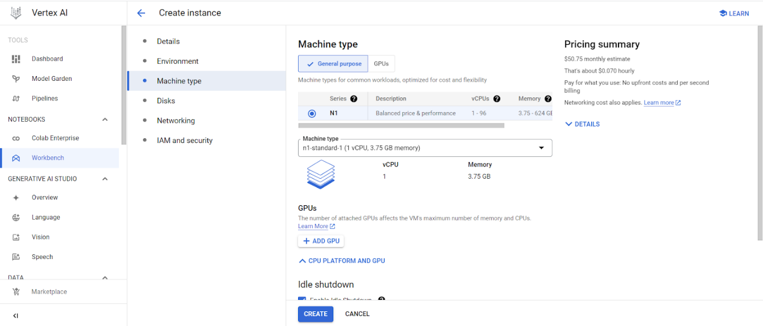
WORKBENCH AND CUSTOM MODEL TRAINING

Slide 19
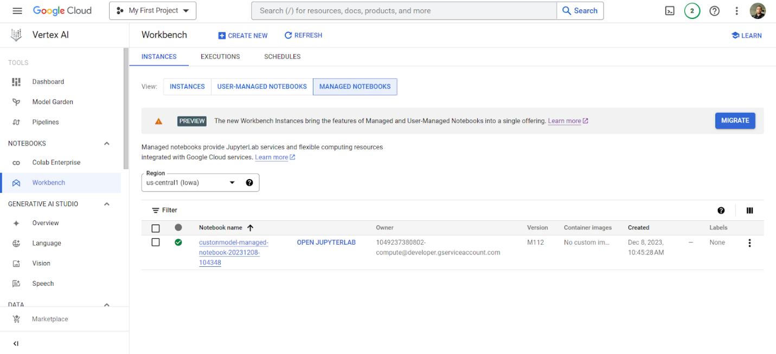
WORKBENCH AND CUSTOM MODEL TRAINING

Slide 20
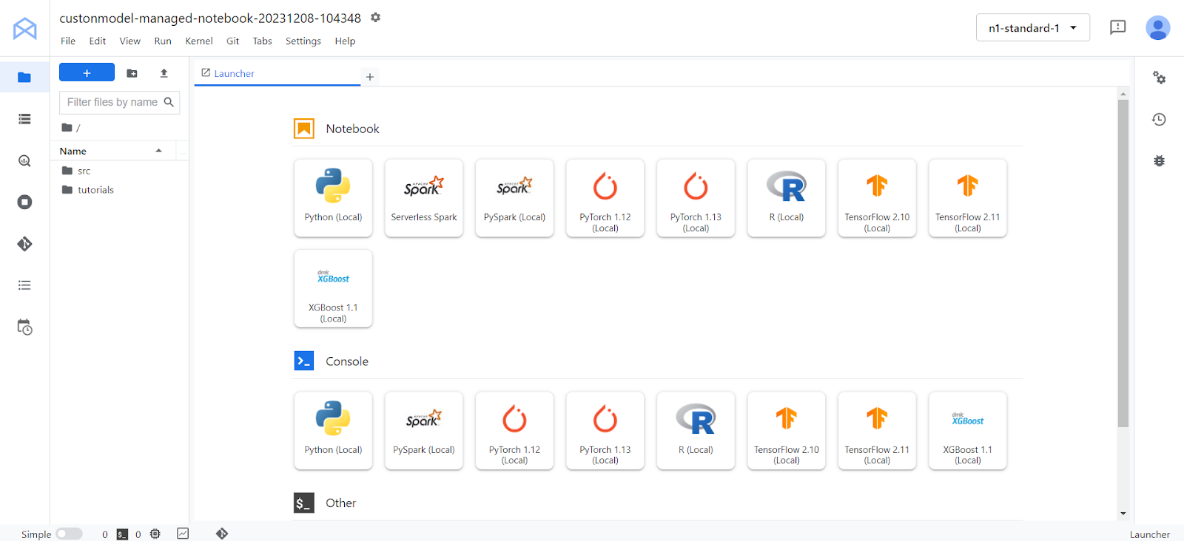
WORKBENCH AND CUSTOM MODEL TRAINING

Slide 21
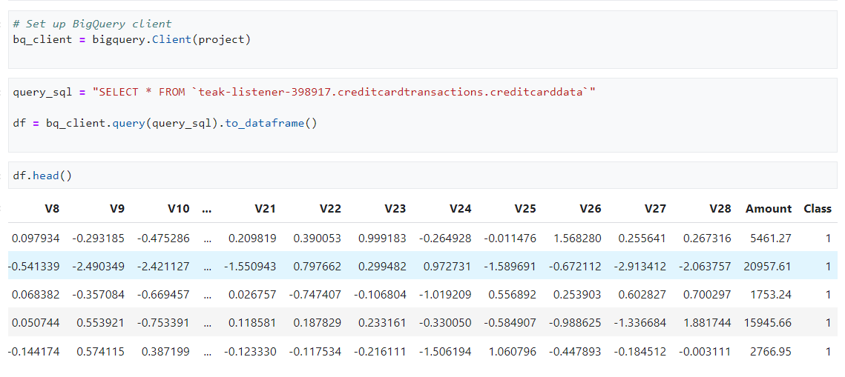
WORKBENCH AND CUSTOM MODEL TRAINING

Slide 22
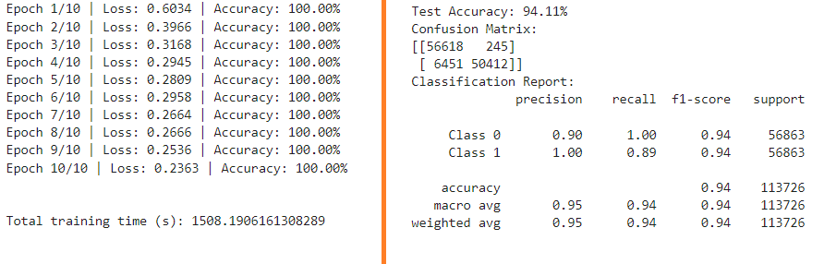
WORKBENCH AND CUSTOM MODEL TRAINING

Slide 23
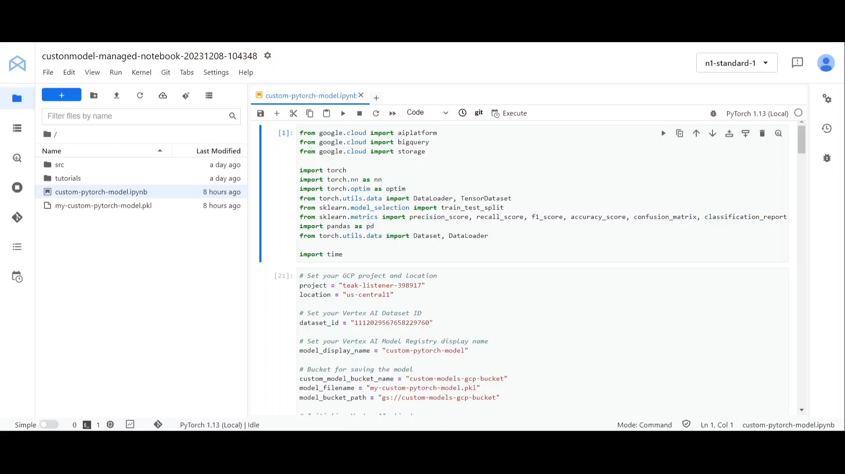
CUSTOM PYTORCH MODEL

Slide 24
AUTOML
Part of Vertex AI to create classification model.
Simply building machine learning models.
Vertex AI Workbench provides managed JupyterLab notebook.
Pytorch for custom model – simple GRU based model.

Slide 25
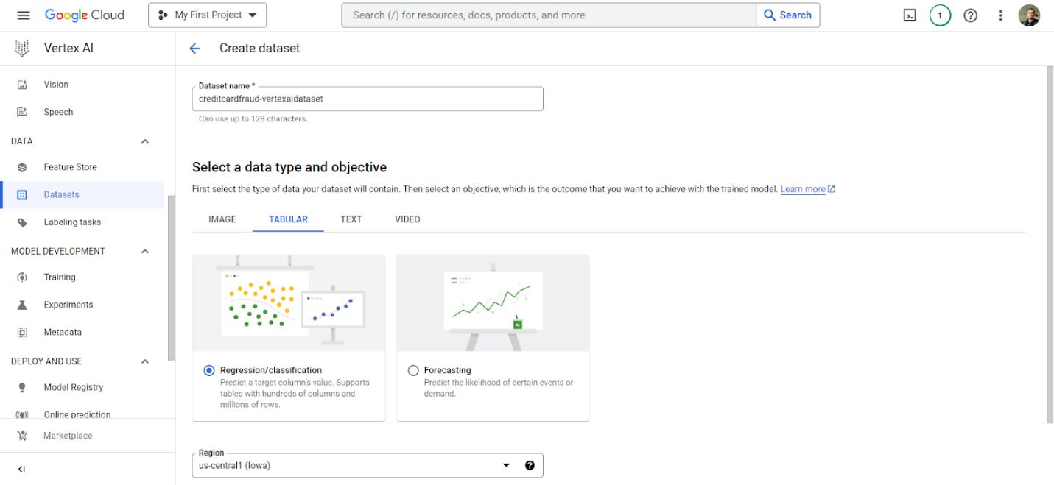
AUTOML

Slide 26
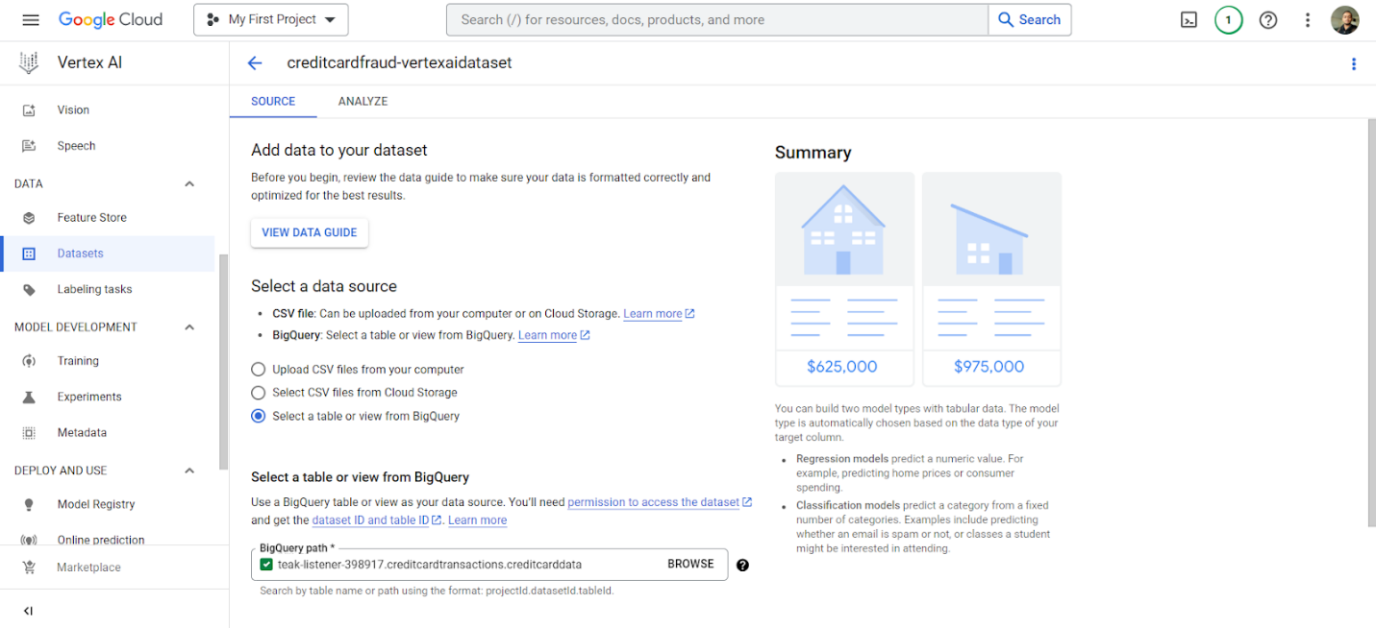
AUTOML

Slide 27
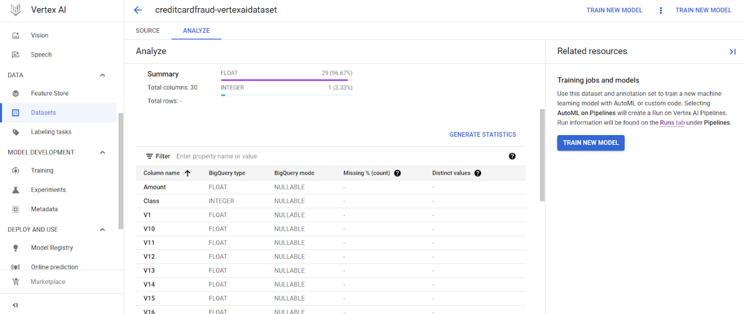
AUTOML

Slide 28
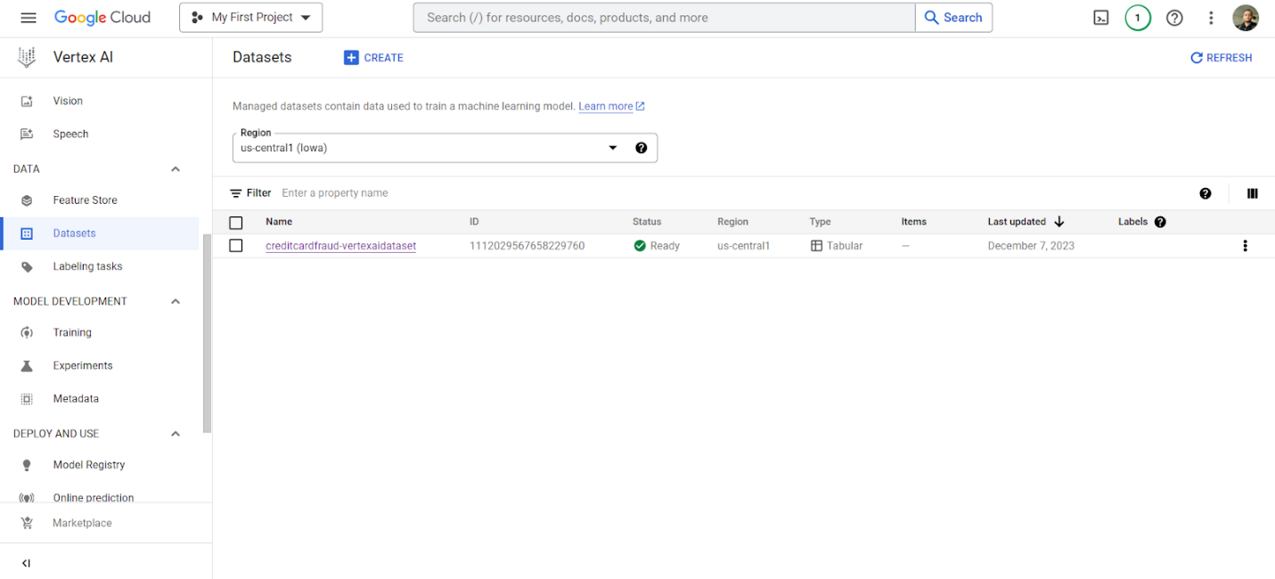
AUTOML

Slide 29
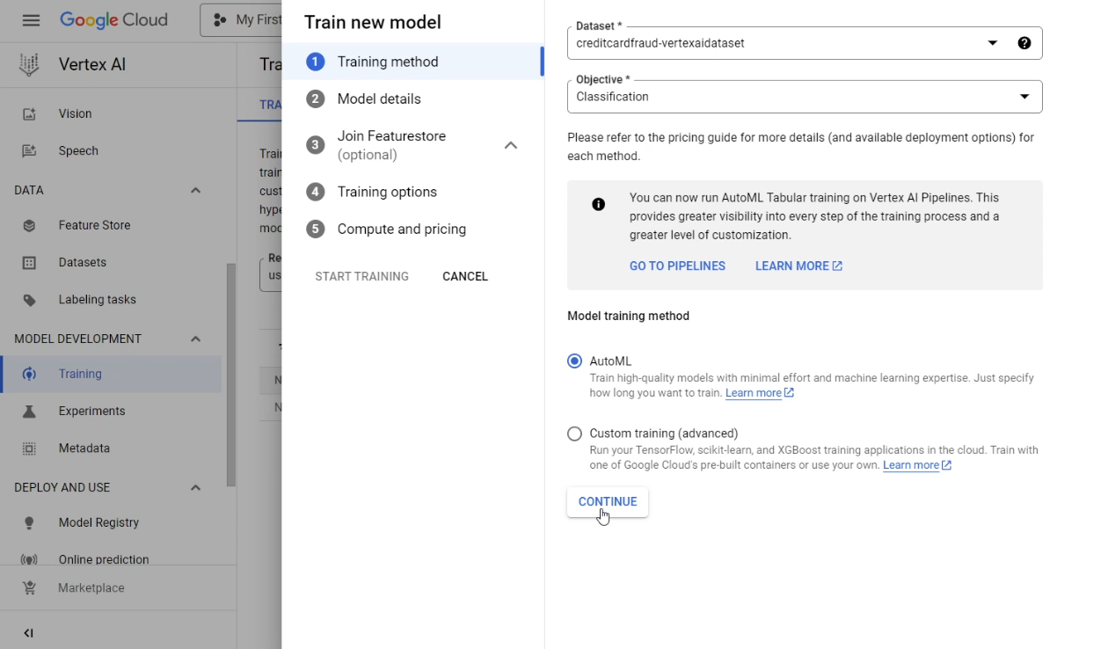
AUTOML

Slide 30
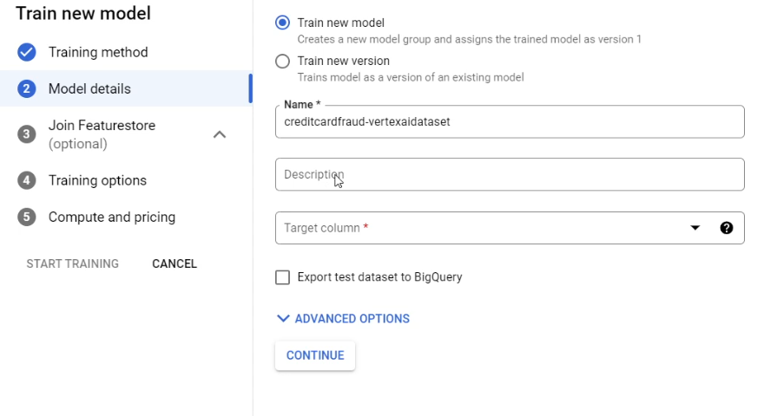
AUTOML

Slide 31
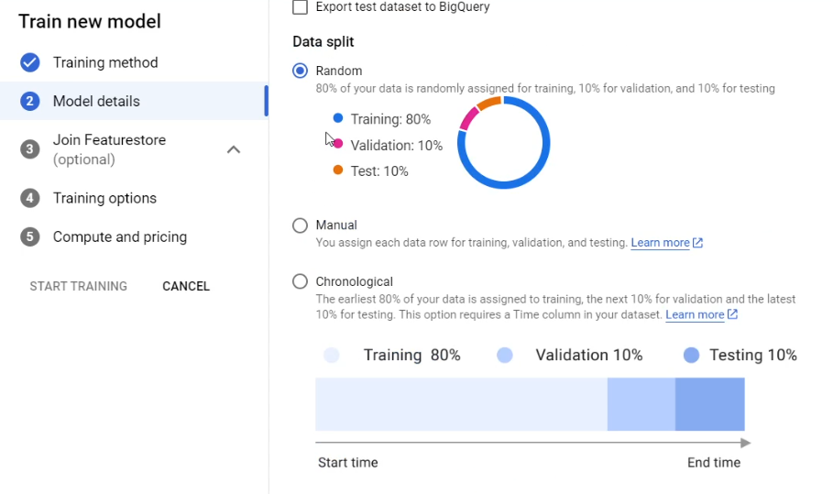
AUTOML

Slide 32
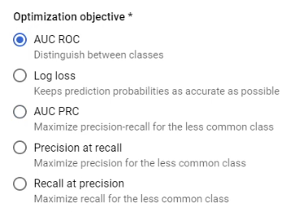
AUTOML

Slide 33
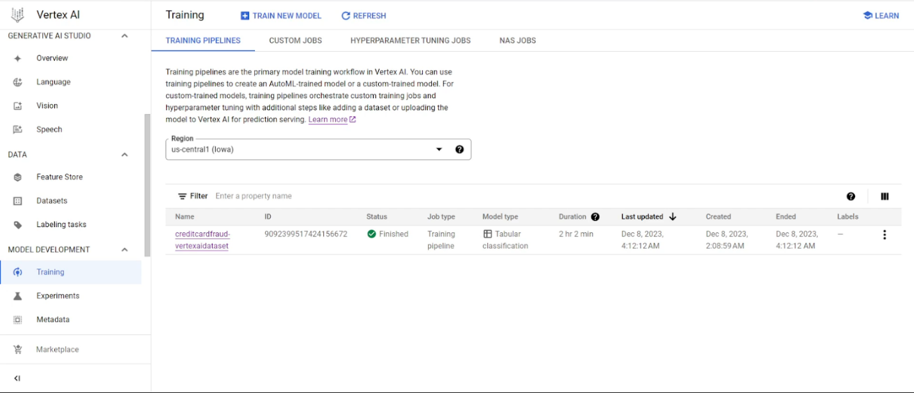
AUTOML

Slide 34
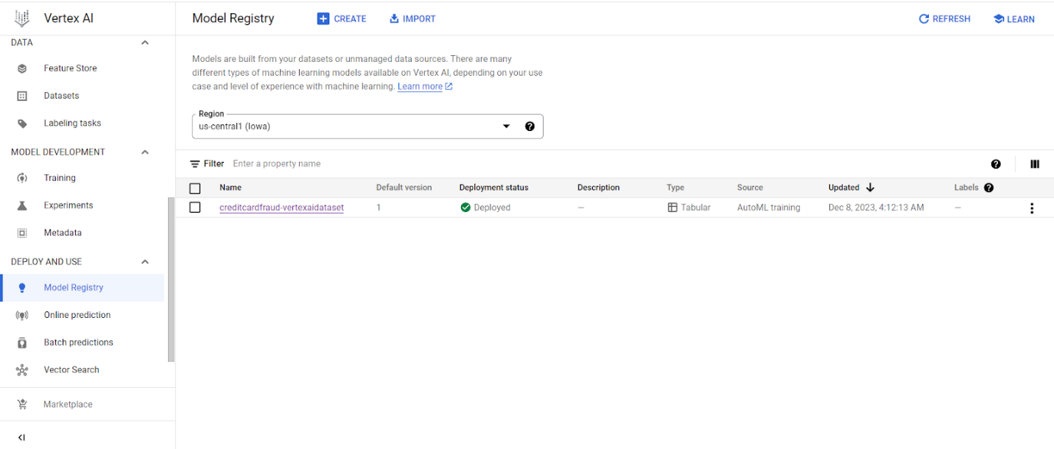
AUTOML

Slide 35
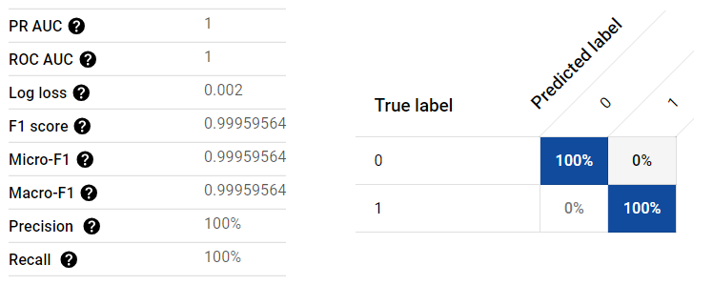
AUTOML
AutoML model gives us a 100% accuracy

Slide 36
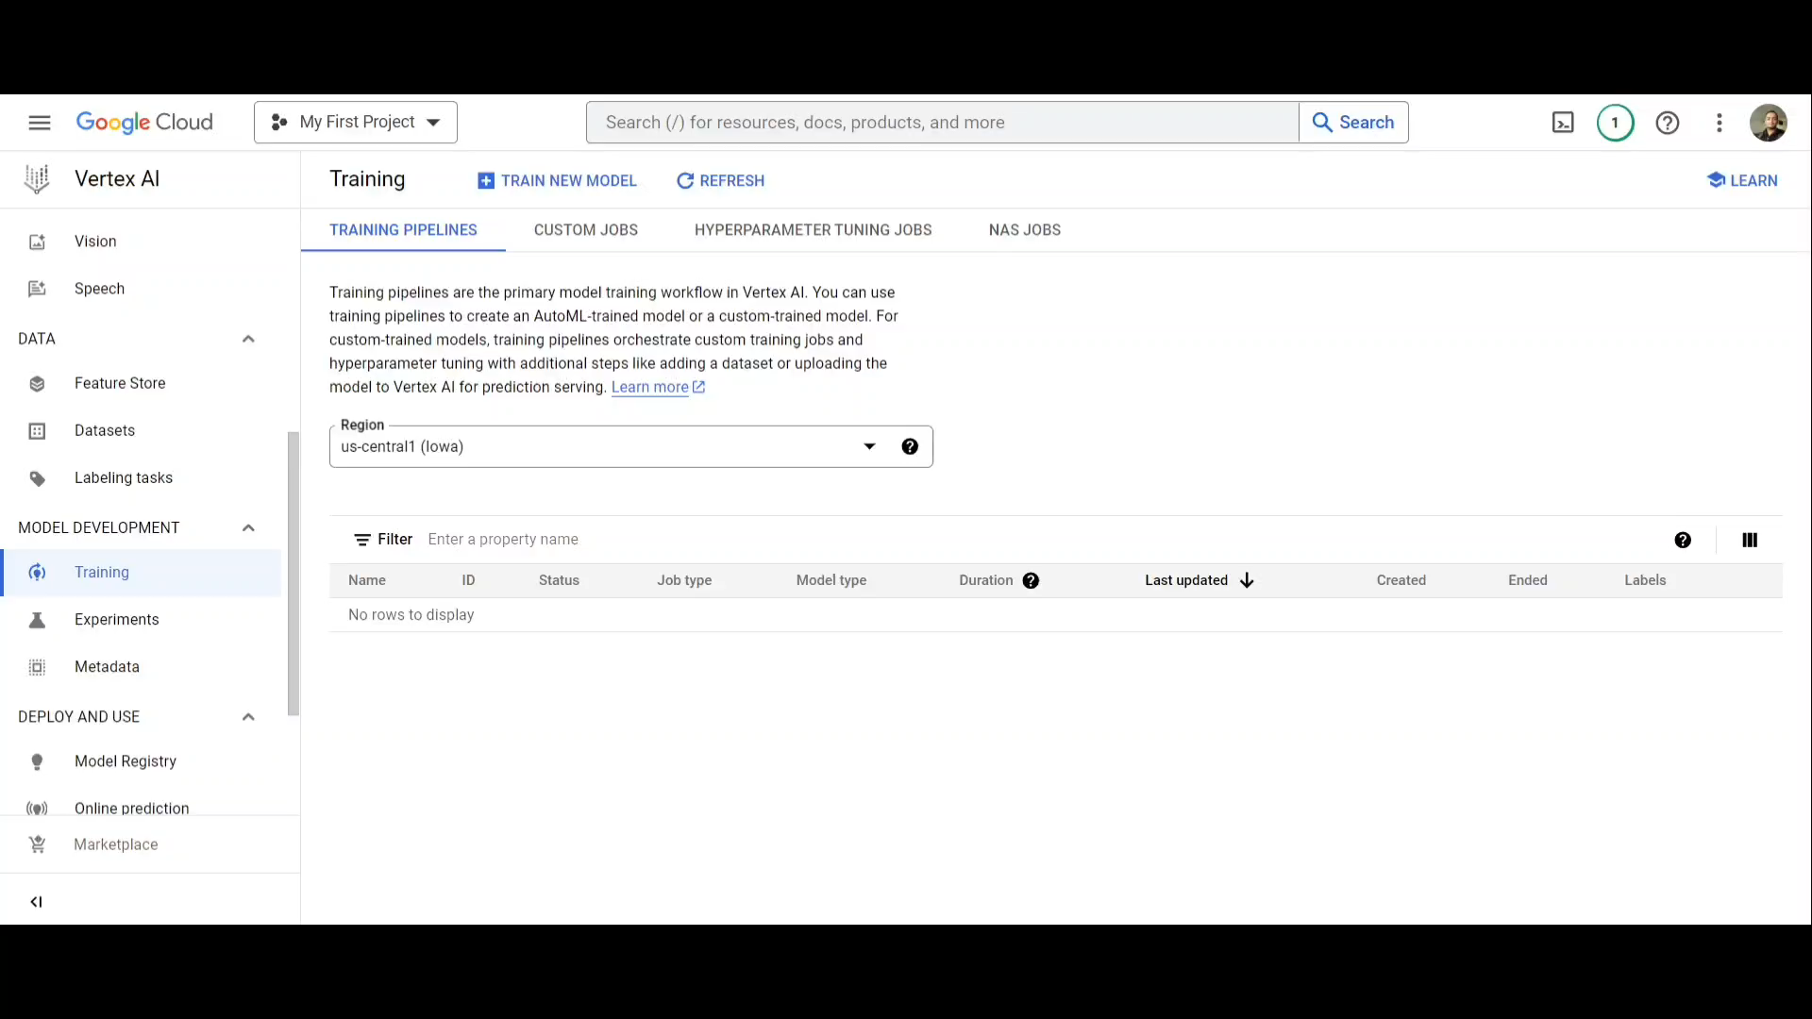
TRAINING-AUTOML MODEL

Slide 37
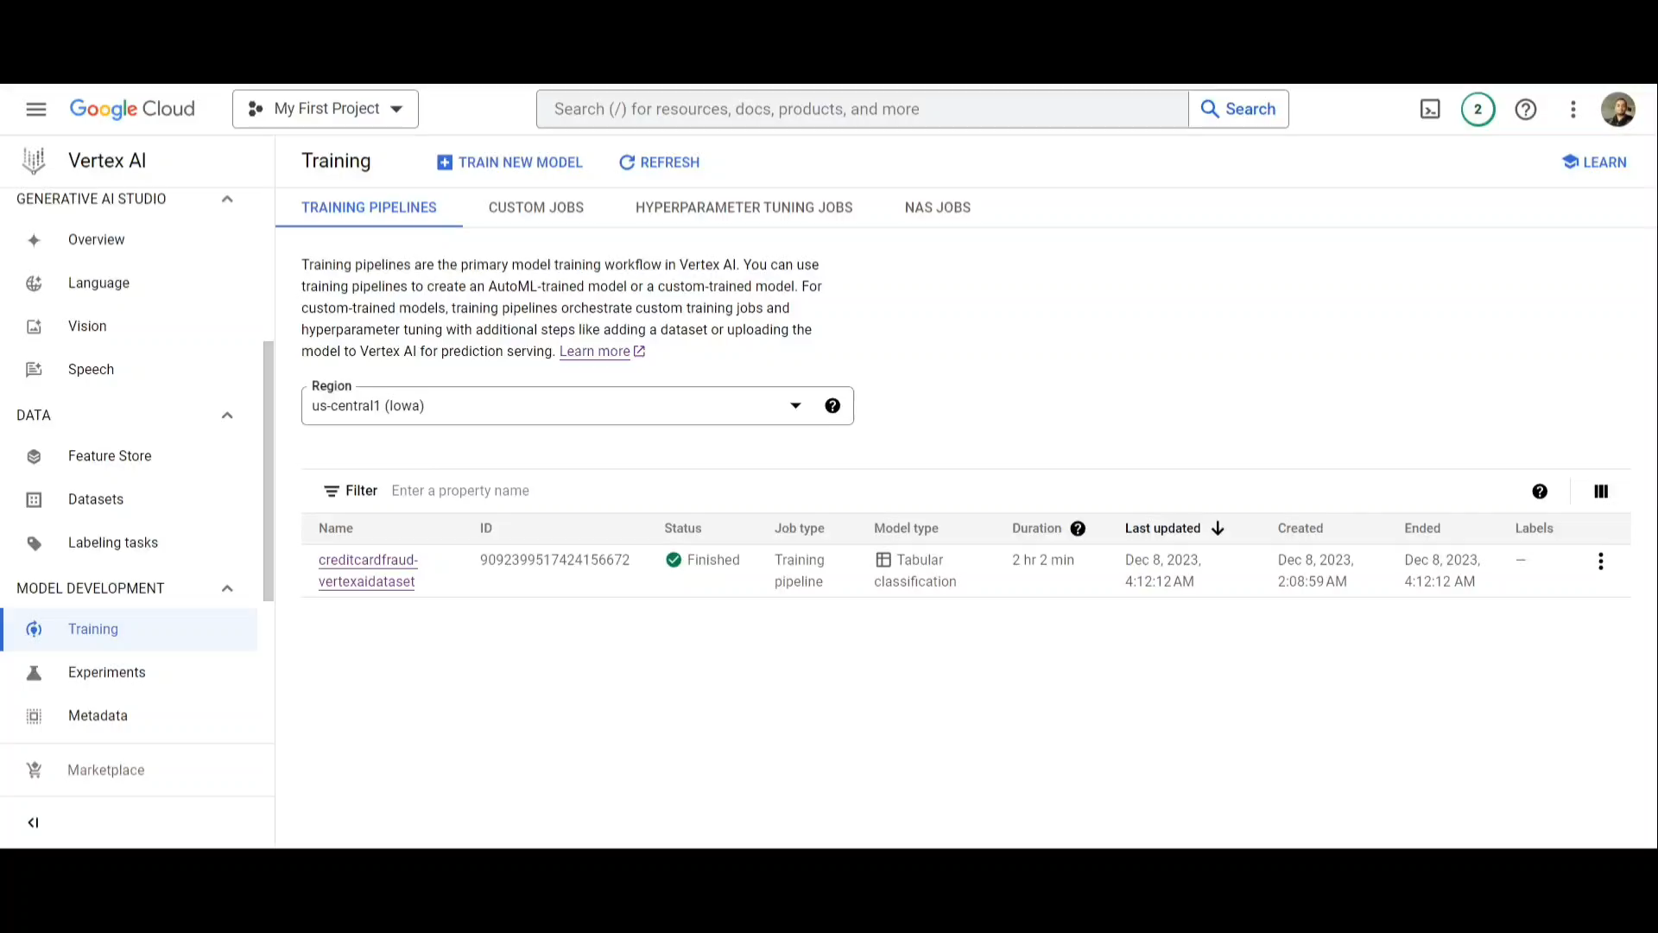
AUTOML MODEL RESULTS

Slide 38
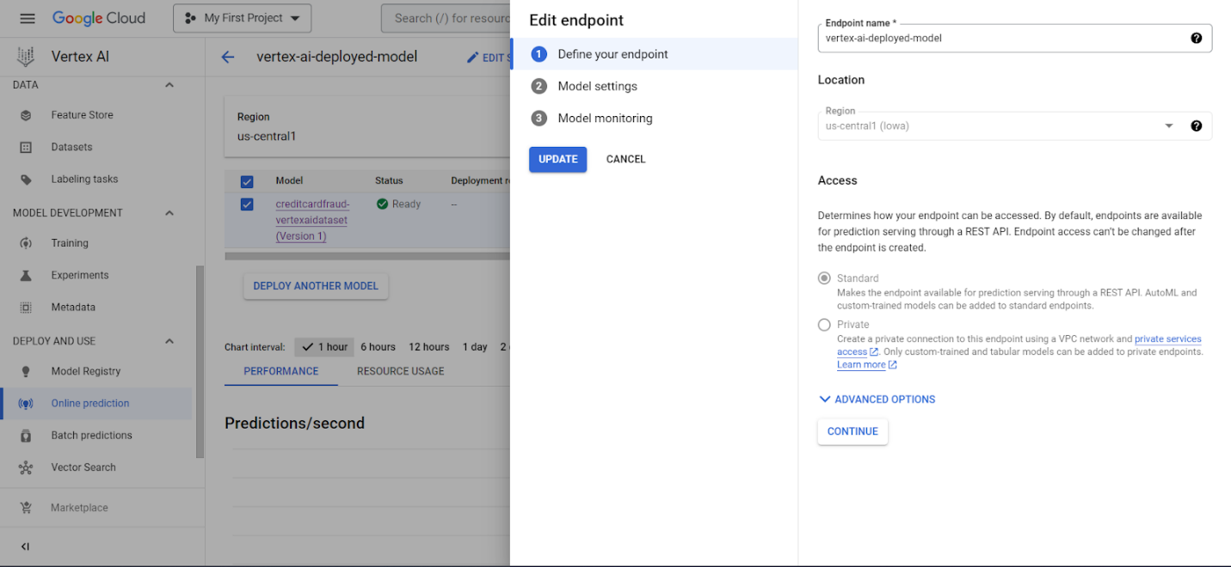
VERTEX AI-ENDPOINT
To deploy a machine learning model in few clicks.
Select the model from the registry and deploy

Slide 39
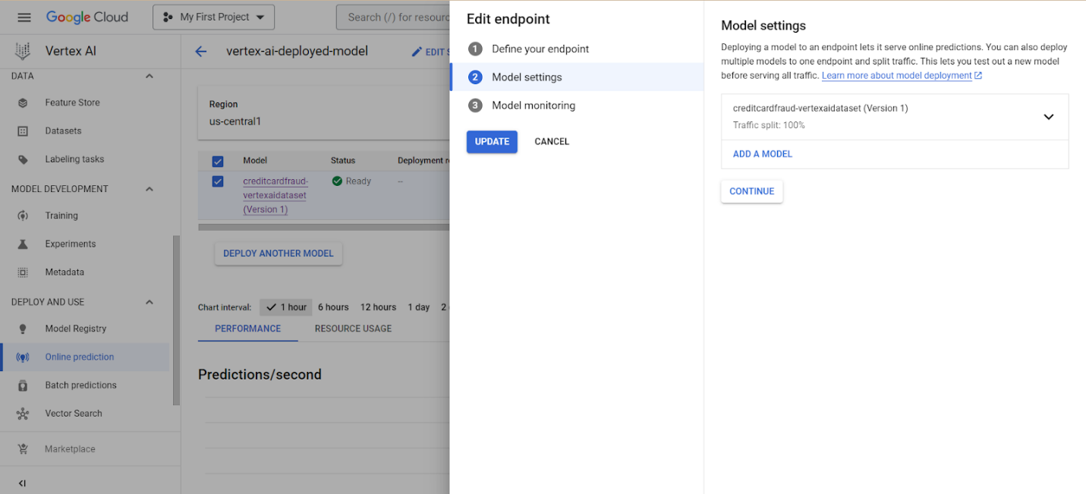
VERTEX AI - ENDPOINT

Slide 40
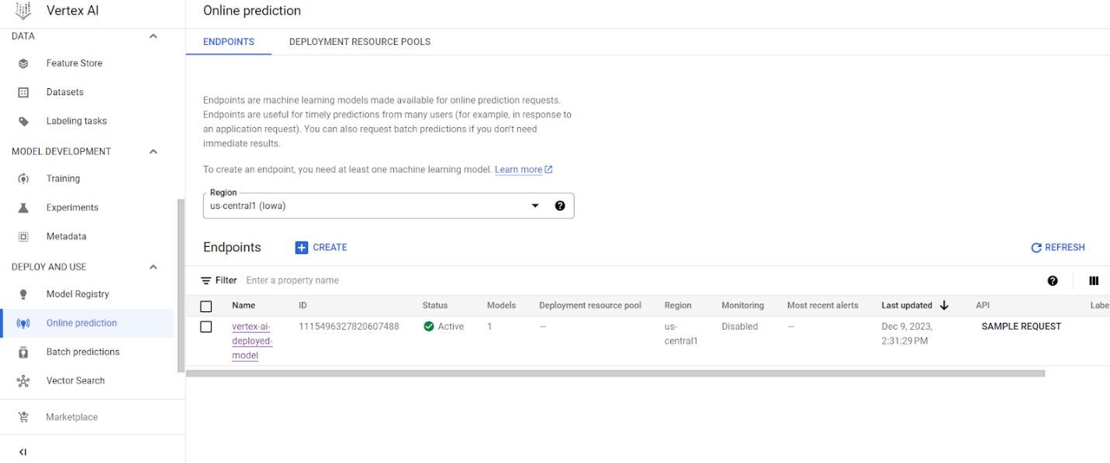
VERTEX AI - ENDPOINT

Slide 41
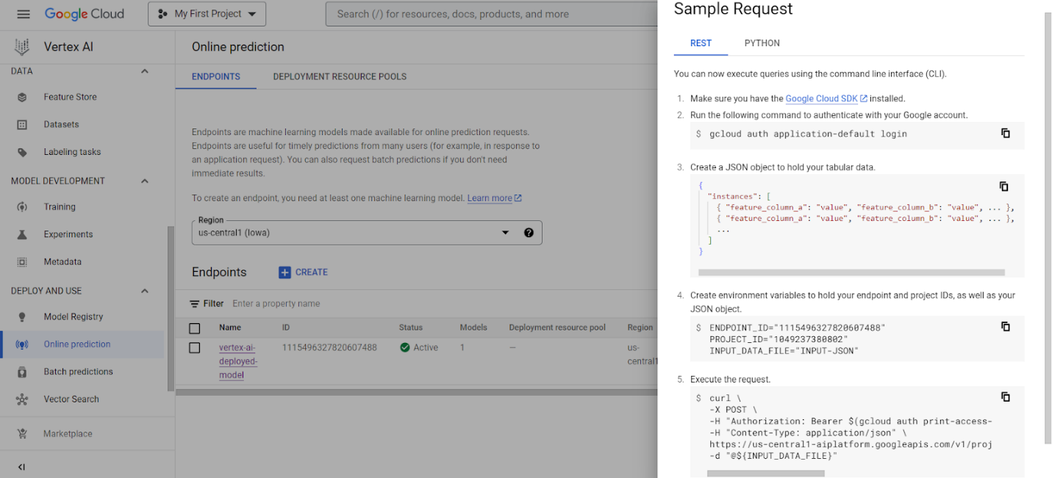
VERTEX AI - ENDPOINT

Slide 42
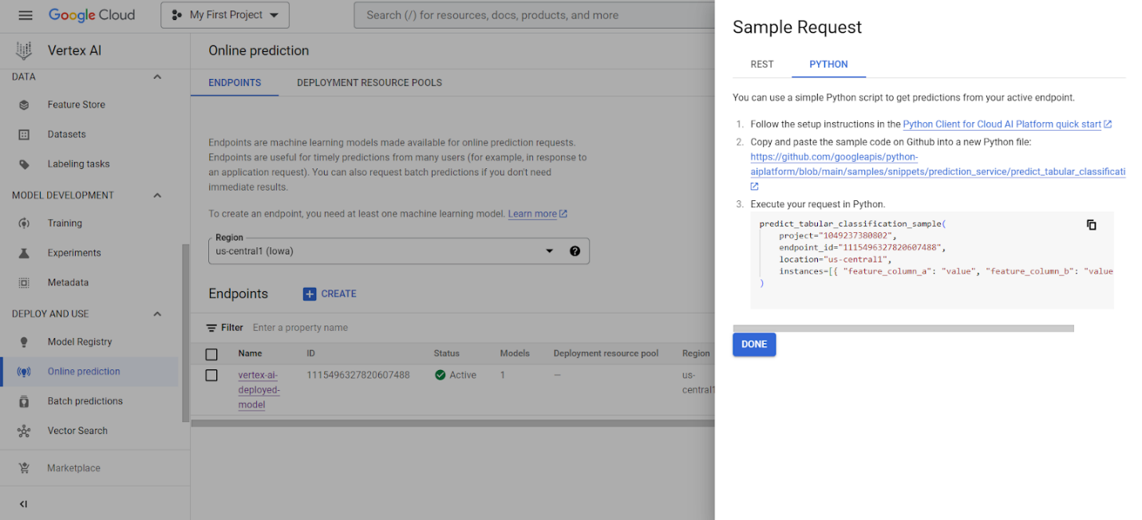
VERTEX AI - ENDPOINT

Slide 43
FUTURE WORK
We can implement a banking application that utilizes the endpoint to classify each transaction passing through it for fraudulent transactions and prevent fraudulent activity in real time.

Slide 44
CONCLUSION
Cloud Storage buckets, BigQuery and Vertex AI – complete end-to-end ML pipeline
AutoML model performed better than the custom model we built.
And is the recommended way to build machine learning models.
$34 – for the entire pipeline
Cost-effective and efficient in terms of both resources and time taken.

Slide 45
Q/A

